Slide 1
Discrete Structure Functions
Week 10
By
Dr. Rafiullah Khan

Slide 2
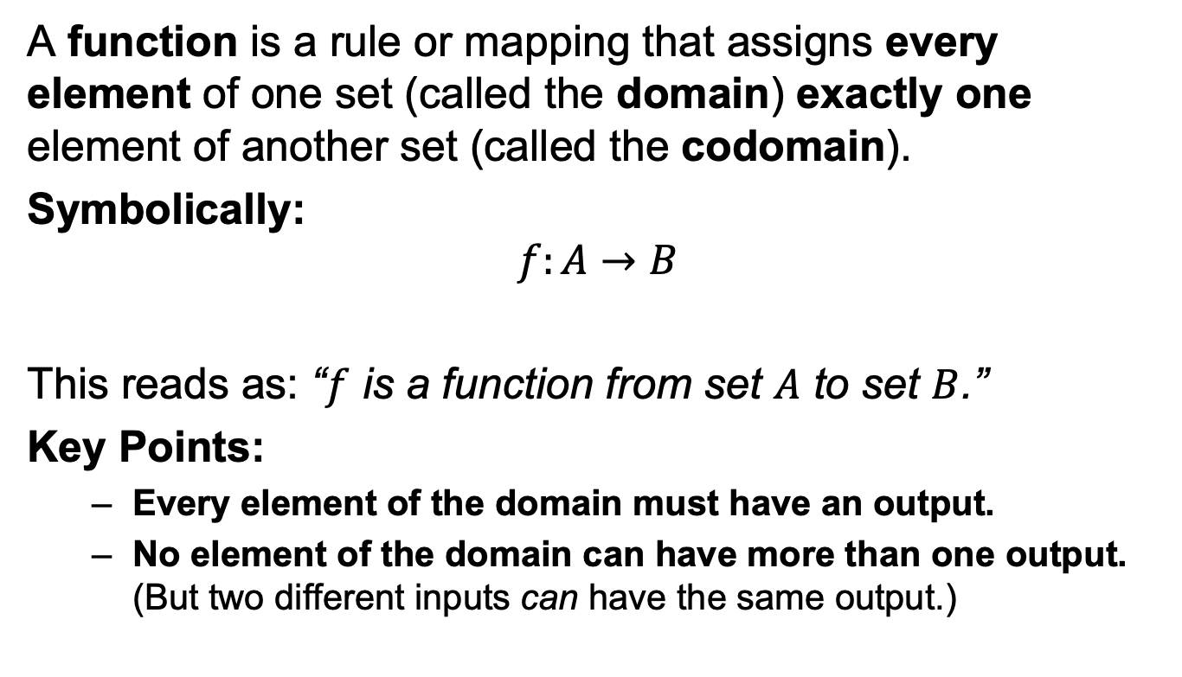
Definition of a Function
A function is a rule or mapping that assigns every element of one set (called the domain) exactly one element of another set (called the codomain).
Symbolically:
$$f:A→B$$
This reads as: “$f$ is a function from set $A$ to set $B$.”
Key Points:
Every element of the domain must have an output.
No element of the domain can have more than one output. (But two different inputs can have the same output.)

Slide 3
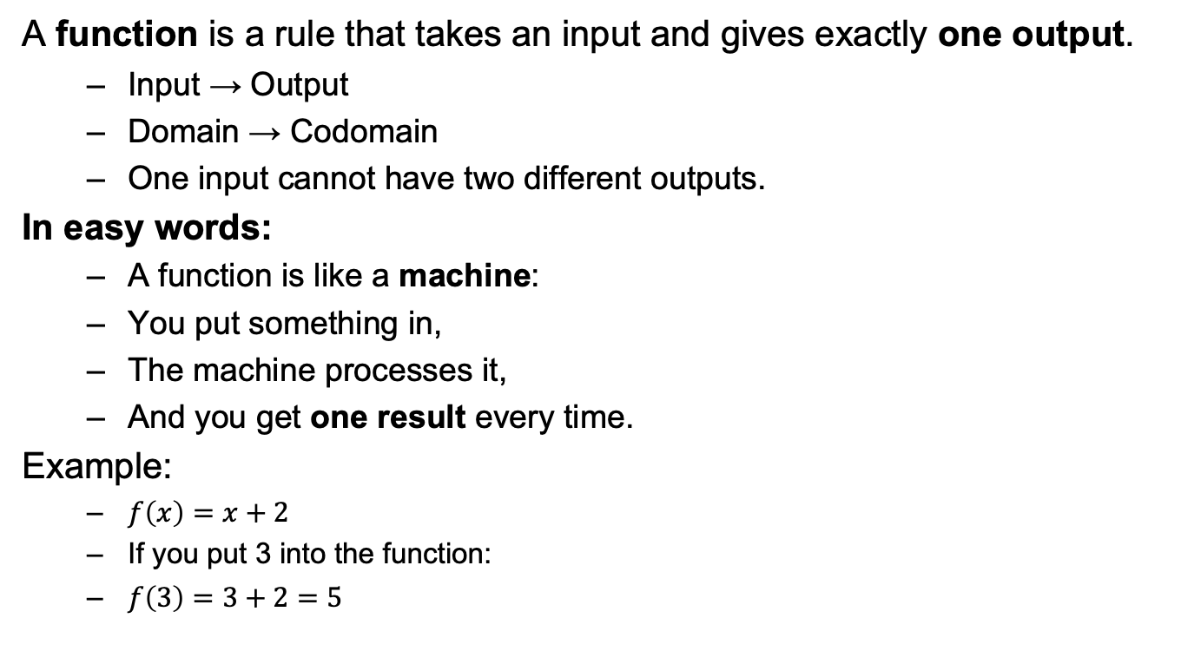
What is a Function?
A function is a rule that takes an input and gives exactly one output.
Input → Output
Domain → Codomain
One input cannot have two different outputs.
In easy words:
A function is like a machine:
You put something in,
The machine processes it,
And you get one result every time.
Example:
$f\left(x\right)=x+2$
If you put 3 into the function:
$f\left(3\right)=3+2=5$

Slide 4
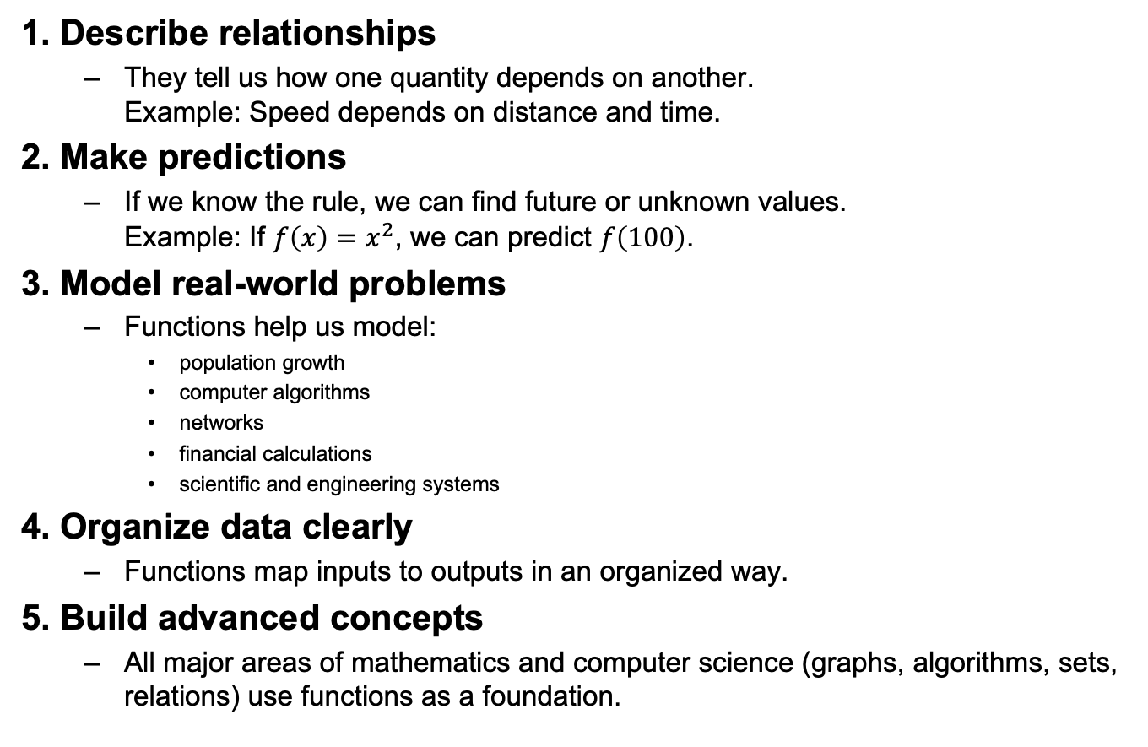
Why Do We Use Functions?
1. Describe relationships
They tell us how one quantity depends on another. Example: Speed depends on distance and time.
2. Make predictions
If we know the rule, we can find future or unknown values. Example: If $f\left(x\right)=x^{2}$, we can predict $f\left(100\right)$.
3. Model real-world problems
Functions help us model:
population growth
computer algorithms
networks
financial calculations
scientific and engineering systems
4. Organize data clearly
Functions map inputs to outputs in an organized way.
5. Build advanced concepts
All major areas of mathematics and computer science (graphs, algorithms, sets, relations) use functions as a foundation.

Slide 5
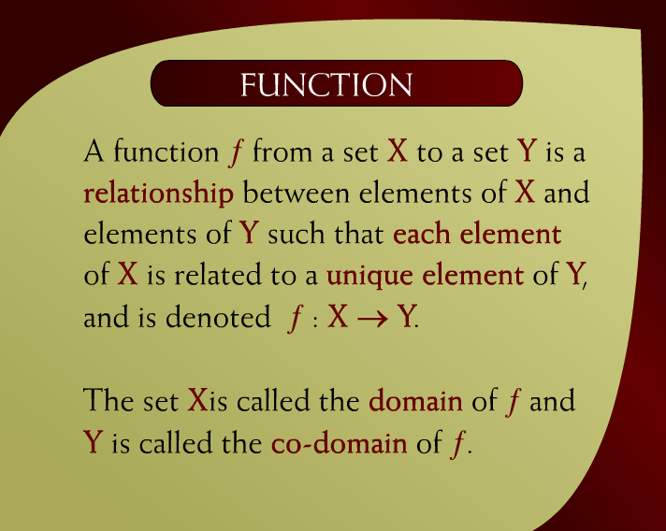
Function – (15 - 5)

Slide 6
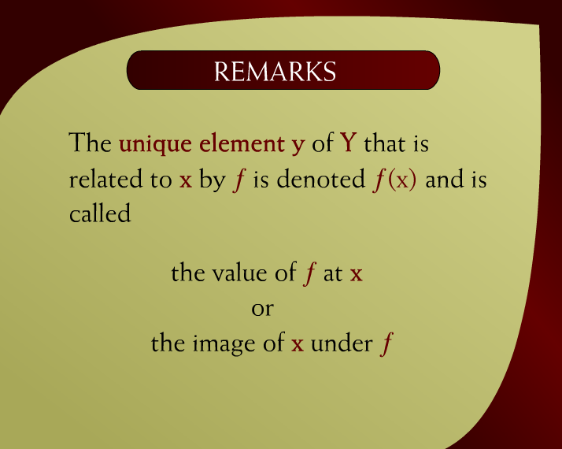
Remarks – (15 – 5a)

Slide 7
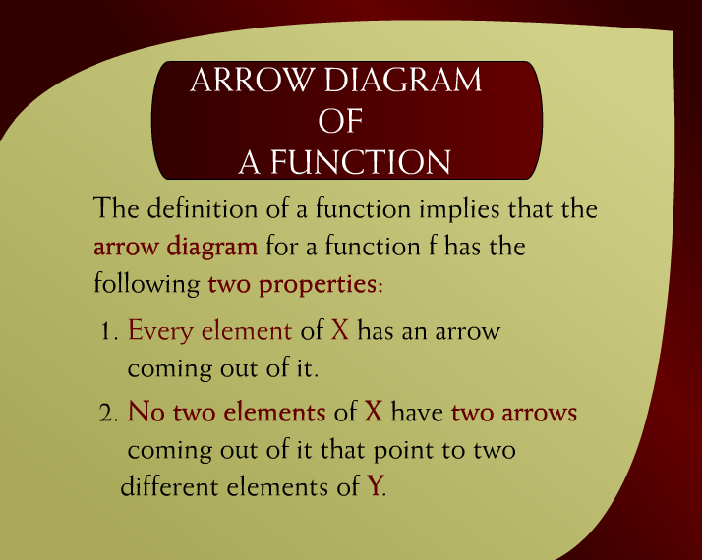
Arrow Diagram of a Function – (15 - 6)

Slide 8
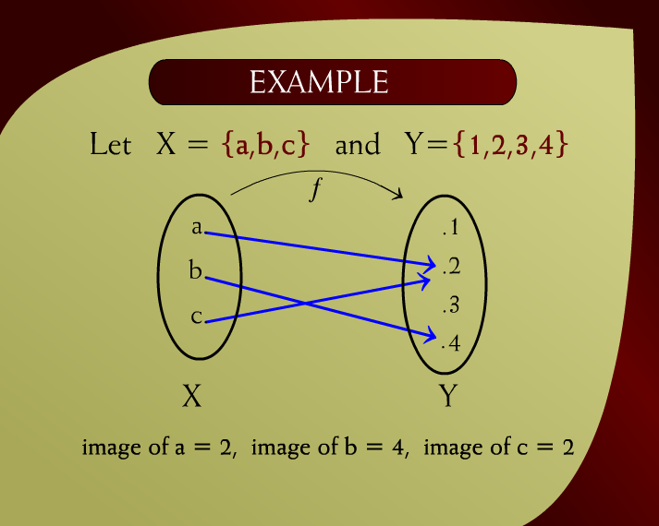
Example – (15 – 6b)

Slide 9
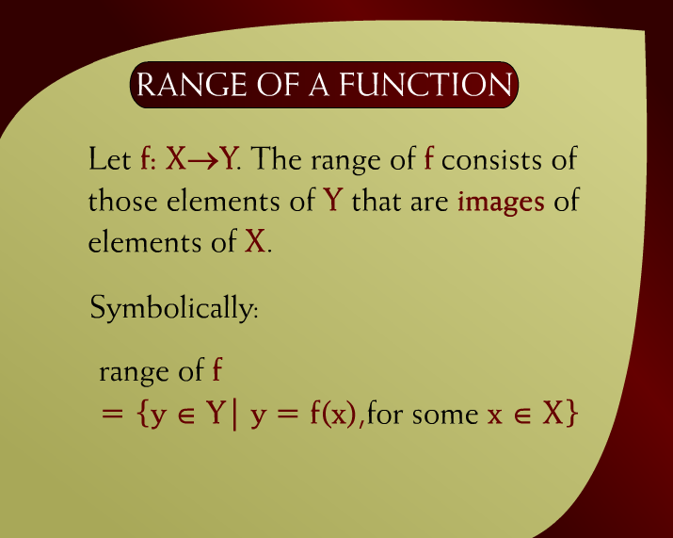
Range of a Function – (15 - 8)

Slide 10
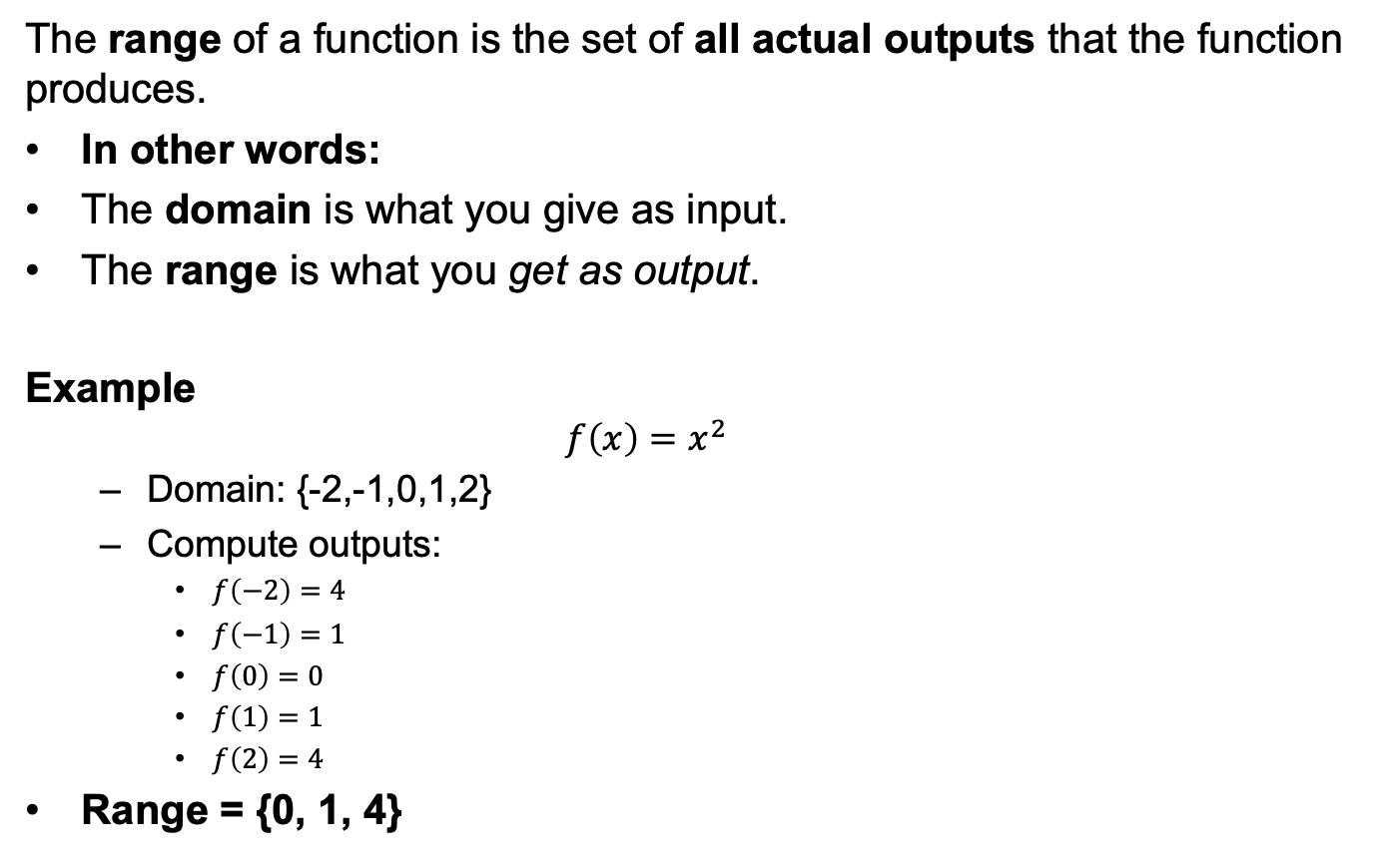
Range of a Function
The range of a function is the set of all actual outputs that the function produces.
In other words:
The domain is what you give as input.
The range is what you get as output.
Example
$$f\left(x\right)=x^{2}$$
Domain: {-2,-1,0,1,2}
Compute outputs:
$f\left(−2\right)=4$
$f\left(−1\right)=1$
$f\left(0\right)=0$
$f\left(1\right)=1$
$f\left(2\right)=4$
Range = {0, 1, 4}

Slide 11

Graph of a Function – (11 - 11)

Slide 12
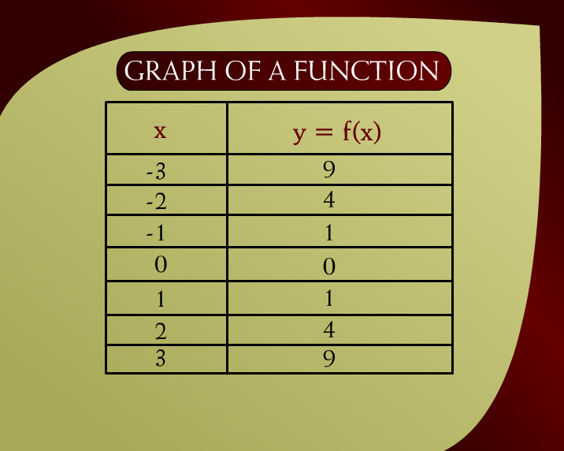
Graph of a Function – (15 – 11a)

Slide 13
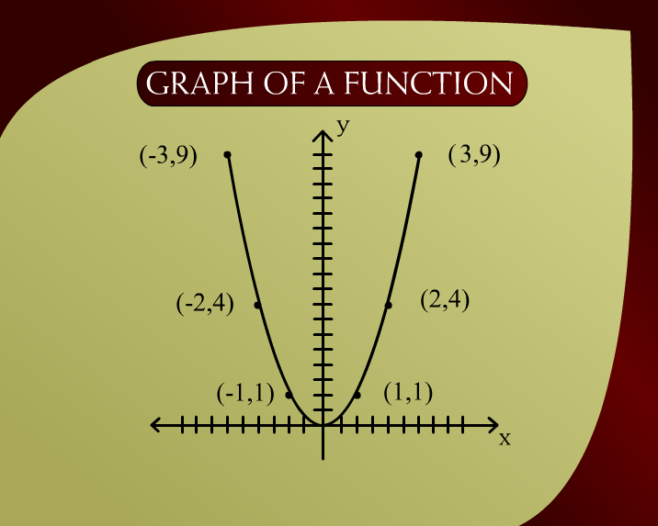
Graph of a Function – (15 – 11b)

Slide 14
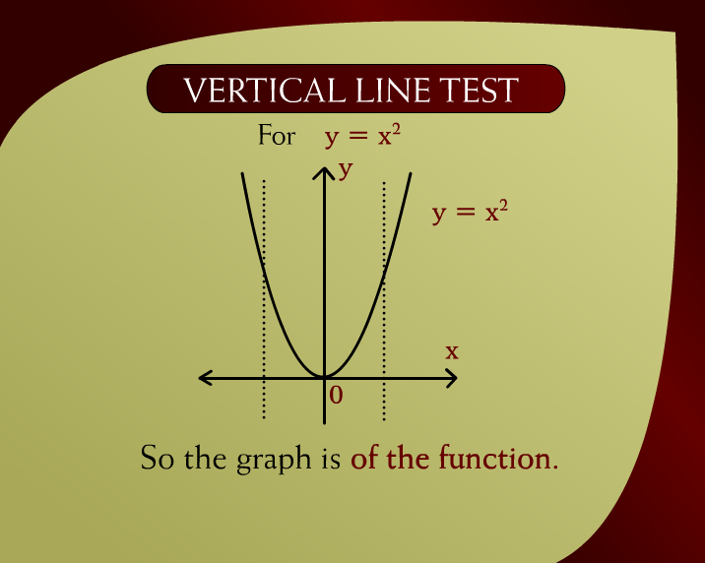
Vertical Line Test – (15 - 12)

Slide 15

Create a Graph
$y={3x}^{2}+1$
$y={2x}^{2}−3x+1$
Where $x=\{−2,−1,0,1,2\}$

Slide 16
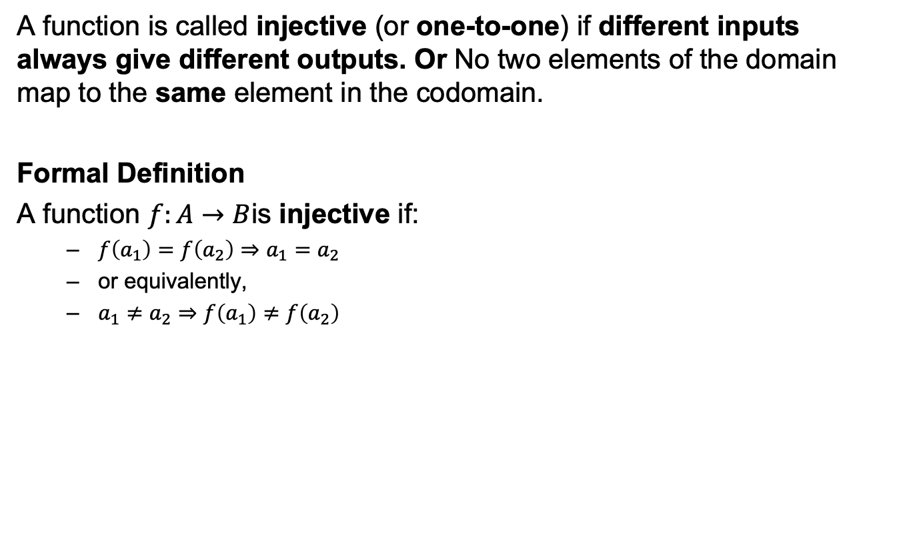
Injective Function (Injection)
A function is called injective (or one-to-one) if different inputs always give different outputs. Or No two elements of the domain map to the same element in the codomain.
Formal Definition
A function $f:A→B$is injective if:
$f\left(a_{1}\right)=f\left(a_{2}\right)⇒a_{1}=a_{2}$
or equivalently,
$a_{1}≠a_{2}⇒f\left(a_{1}\right)≠f\left(a_{2}\right)$

Slide 17
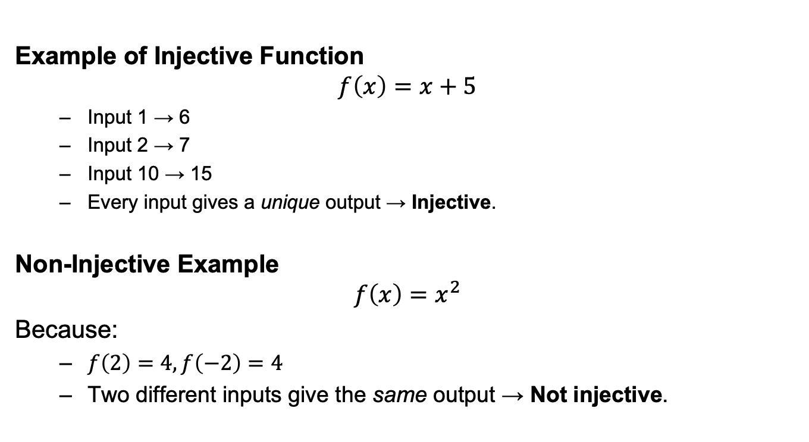
Example of Injective Function
Example of Injective Function
$$f\left(x\right)=x+5$$
Input 1 → 6
Input 2 → 7
Input 10 → 15
Every input gives a unique output → Injective.
Non-Injective Example
$$f\left(x\right)=x^{2}$$
Because:
$f\left(2\right)=4, f\left(−2\right)=4$
Two different inputs give the same output → Not injective.

Slide 18
Recursion
Recursion is a method of defining something in terms of itself.
In simple words:
A recursive definition has:
A base case (the simplest form)
A recursive step (the rule that builds new values from previous ones)

Slide 19
Why Do We Use Recursion?
Because some problems are easiest to solve by breaking them into smaller versions of the same problem.
Examples:
factorial
Fibonacci series
tree traversal
divide & conquer algorithms
mathematical definitions (sum, power, sequences)

Slide 20
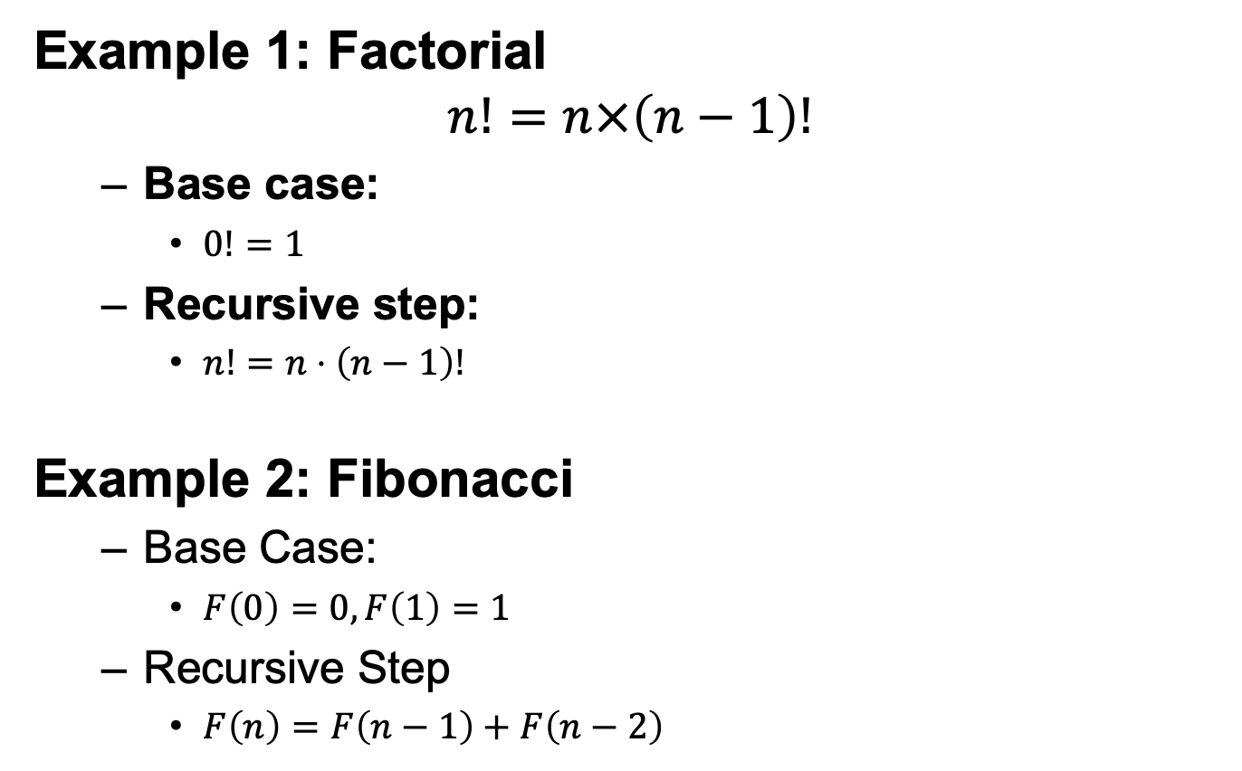
Examples of Recursion
Example 1: Factorial
$$n!=n×\left(n−1\right)!$$
Base case:
$0!=1$
Recursive step:
$n!=n⋅\left(n−1\right)!$
Example 2: Fibonacci
Base Case:
$F\left(0\right)=0, F\left(1\right)=1$
Recursive Step
$F\left(n\right)=F\left(n−1\right)+F\left(n−2\right)$

Slide 21
Recursive Factorial Function
Compute the factorial function F(n) = n! for an arbitrary nonnegative integer n. Since
n! = 1 . . . . . (n − 1) . n = (n − 1)! . n for n ≥ 1
and 0! = 1 by definition,
we can compute F(n) = F(n − 1) . n with the following recursive algorithm.
ALGORITHM Fact(n)
{
if n = 0
return 1
else
return Fact(n − 1) ∗ n
}

Slide 22
Fibonacci Recursive Function
Fib(N)
{ if (N <= 1)
return 1;
else
return Fib(N-1) + Fib(N-2)
}

Slide 23
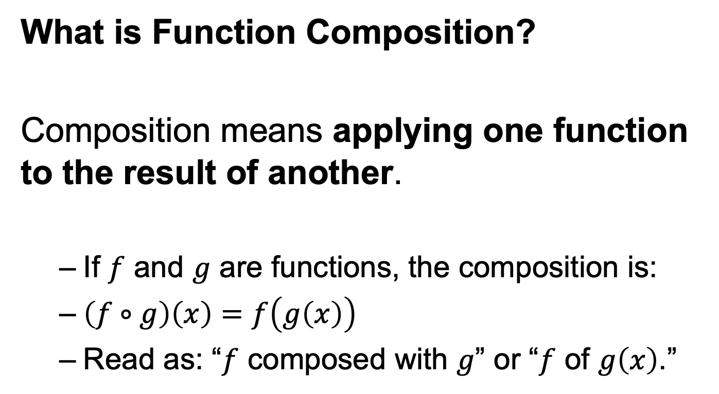
Composition of Functions
What is Function Composition?
Composition means applying one function to the result of another.
If $f$ and $g$ are functions, the composition is:
$\left(f∘g\right)\left(x\right)=f\left(g\left(x\right)\right)$
Read as: “$f$ composed with $g$” or “$f$ of $g\left(x\right)$”.

Slide 24
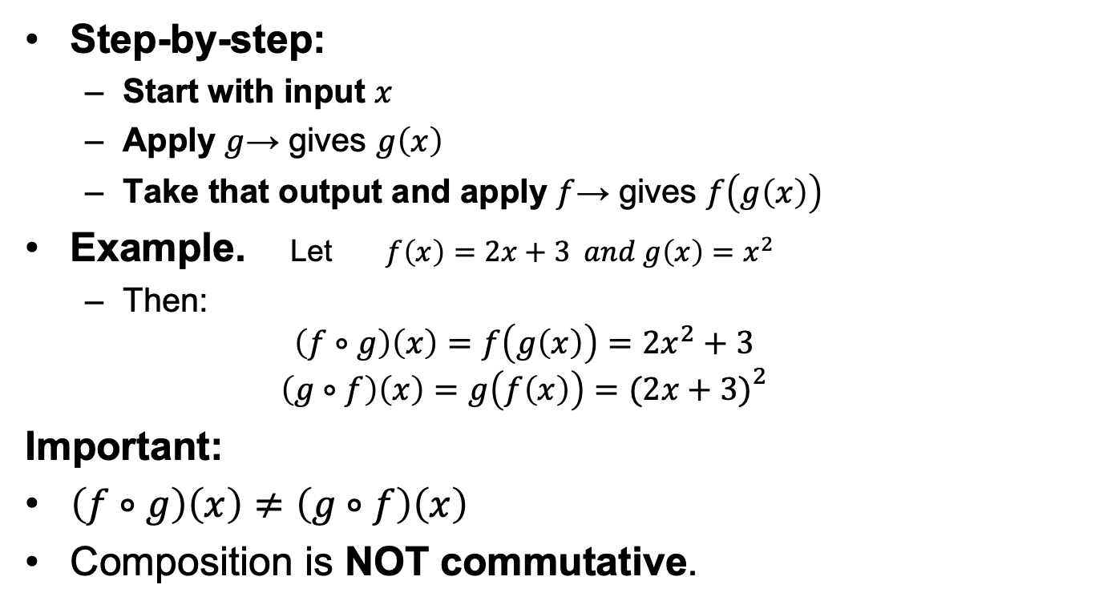
How It Works
Step-by-step:
Start with input $x$
Apply $g$→ gives $g\left(x\right)$
Take that output and apply $f$→ gives $f\left(g\left(x\right)\right)$
Example. Let $f\left(x\right)=2x+3 and g\left(x\right)=x^{2}$
Then:
$$\left(f∘g\right)\left(x\right)=f\left(g\left(x\right)\right)=2x^{2}+3$$
$$\left(g∘f\right)\left(x\right)=g\left(f\left(x\right)\right)=(2x+3{\left.)\right.}^{2}$$
Important:
$\left(f∘g\right)\left(x\right)≠\left(g∘f\right)\left(x\right)$
Composition is NOT commutative.

Slide 25
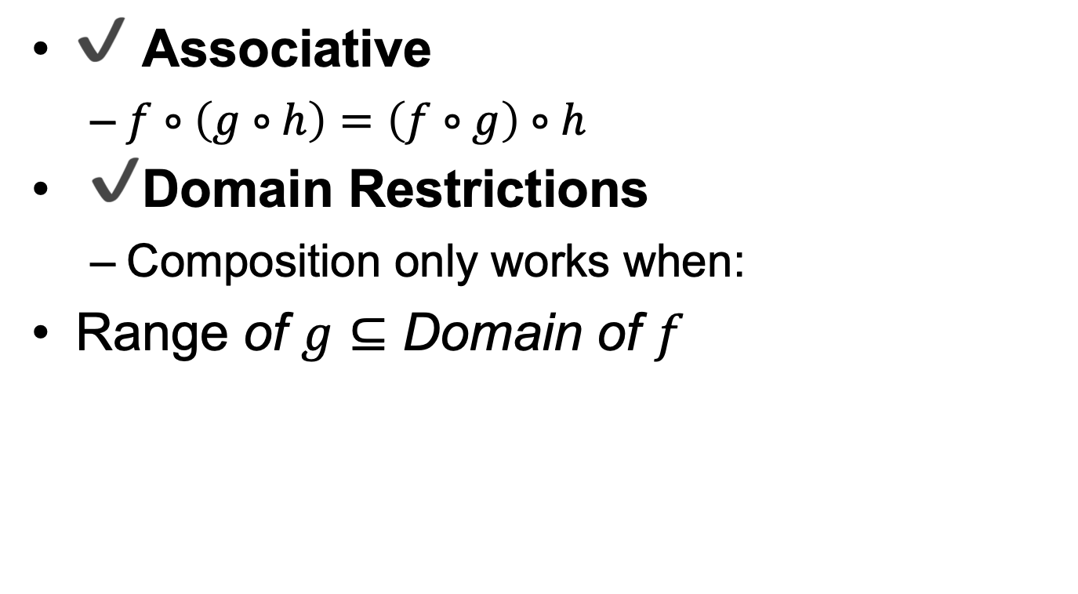
Properties of Composition
✔ Associative
$f∘\left(g∘h\right)=\left(f∘g\right)∘h$
✔ Domain Restrictions
Composition only works when:
$\text{Range} \text{of} g⊆\text{Domain} \text{of} f$

Slide 26
Why Composition Matters?
Composition is used to model multi-step processes:
Data processing pipelines
Machine Learning transformations
Cryptographic functions
Nested formulas
Function iteration (e.g., Newton’s Method)

Slide 27
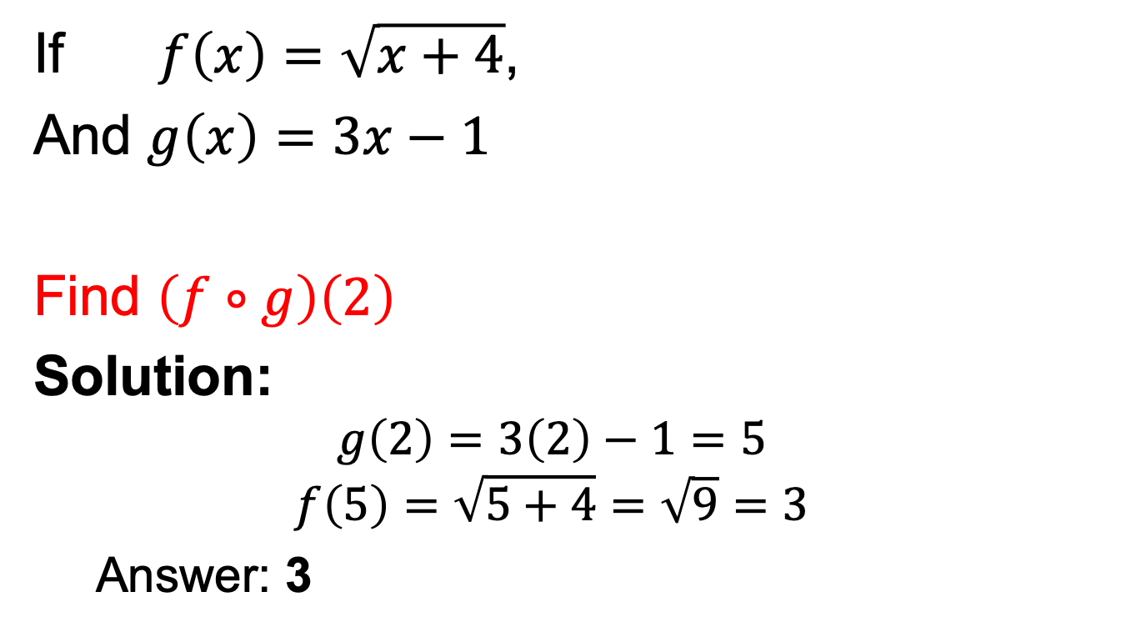
Practice Question
If $f\left(x\right)=\sqrt{x+4}$,
And $g\left(x\right)=3x−1$
Find $\left(f∘g\right)\left(2\right)$
Solution:
$$g\left(2\right)=3\left(2\right)−1=5$$
$$f\left(5\right)=\sqrt{5+4}=\sqrt{9}=3$$
Answer: 3

Slide 28
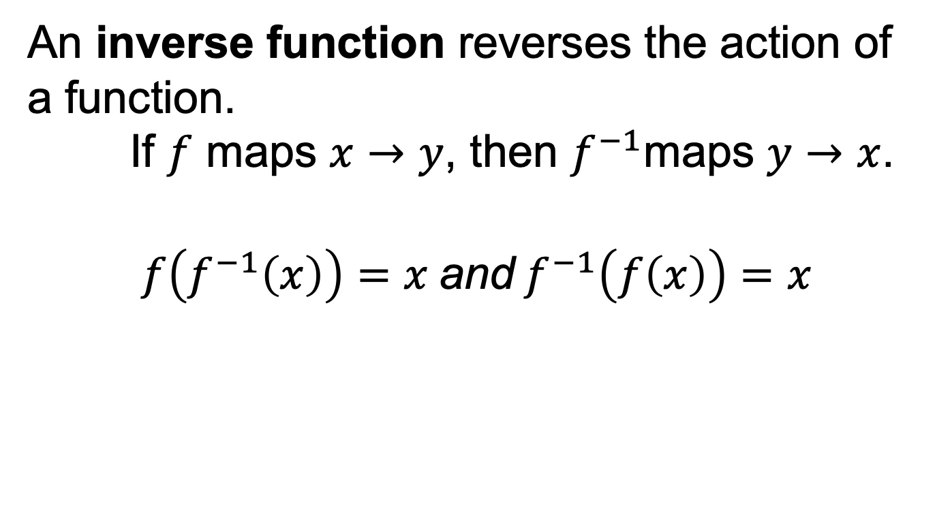
Inverse Functions
An inverse function reverses the action of a function. If $f$ maps $x→y$, then $f^{−1}$maps $y→x$.
$$f\left(f^{−1}\left(x\right)\right)=x \text{and} f^{−1}\left(f\left(x\right)\right)=x$$

Slide 29
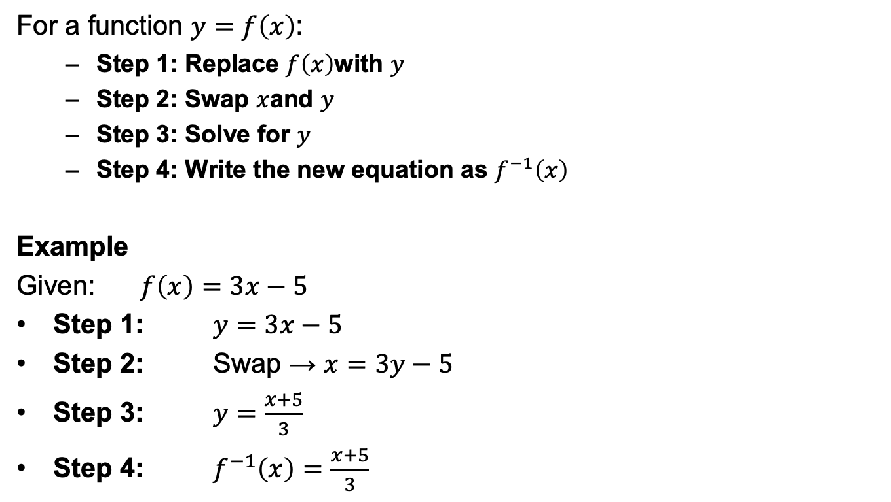
How to Find the Inverse
For a function $y=f\left(x\right)$:
Step 1: Replace $f\left(x\right)$with $y$
Step 2: Swap $x$and $y$
Step 3: Solve for $y$
Step 4: Write the new equation as $f^{−1}\left(x\right)$
Example
Given: $f\left(x\right)=3x−5$
Step 1: $y=3x−5$
Step 2: Swap → $x=3y−5$
Step 3: $y=\frac{x+5}{3}$
Step 4: $f^{−1}\left(x\right)=\frac{x+5}{3}$

Slide 30
Special Functions
Special functions are widely-used mathematical functions that appear frequently in:
Calculus
Engineering
Computer Science
Physics
Statistics
They provide standard solutions to many common problems.

Slide 31
Types of Special Functions
Polynomial Functions
Exponential Functions
Logarithmic Functions
Trigonometric Functions
Piecewise & Discrete Special Functions
Why Special Functions Matter
Simplify complex mathematical models
Used as building blocks for approximation
Form basis of calculus, differential equations
Essential in computer science: algorithms, complexity, ML

Slide 32
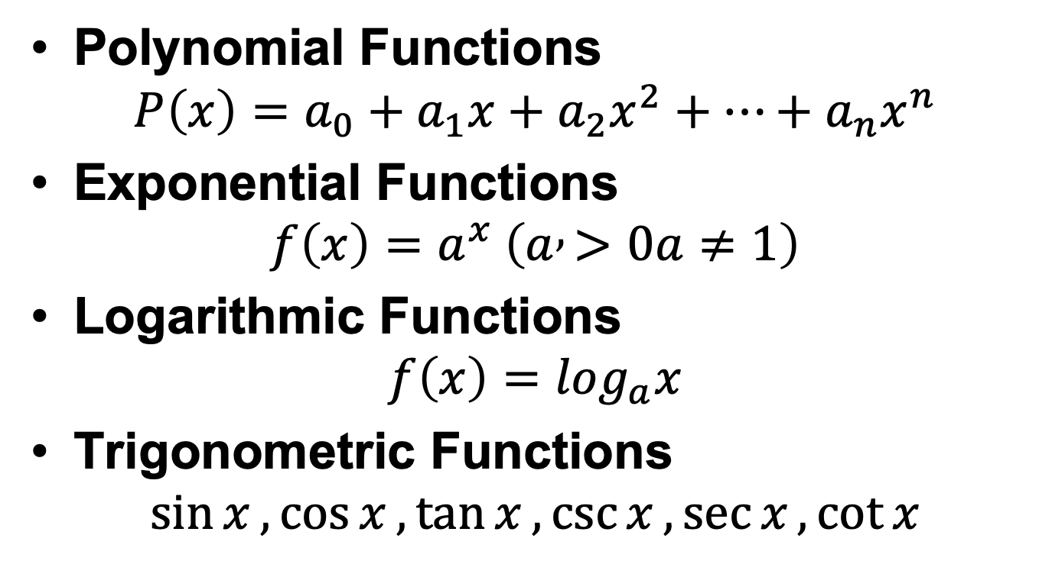
Special Functions
Polynomial Functions
$$P\left(x\right)=a_{0}+a_{1}x+a_{2}x^{2}+⋯+a_{n}x^{n}$$
Exponential Functions
$$f\left(x\right)=a^{x} \left(a , >0a≠1\right)$$
Logarithmic Functions
$$f\left(x\right)=\log_{a}x$$
Trigonometric Functions
$$\sin{x},\cos{x},\tan{x},\csc{x},\sec{x},\cot{x}$$

Slide 33
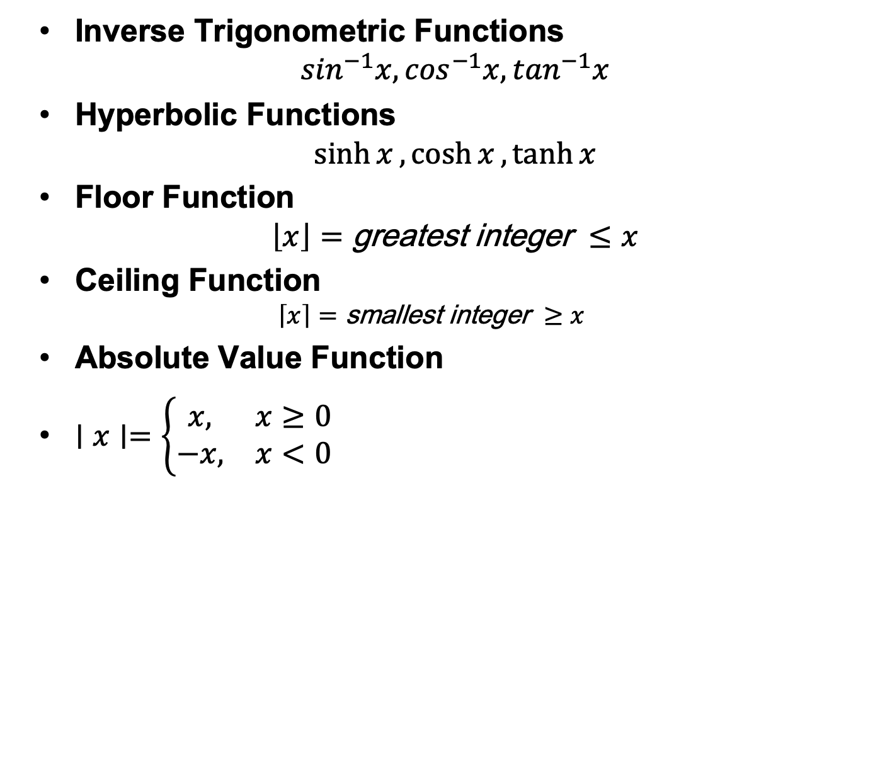
Special Functions
Inverse Trigonometric Functions
$$\sin^{−1}x,\cos^{−1}x,\tan^{−1}x$$
Hyperbolic Functions
$$\sinh{x},\cosh{x},\tanh{x}$$
Floor Function
$$\left\lfloor x\right\rfloor =\text{greatest} \text{integer} ≤x$$
Ceiling Function
$$\left\lceil x\right\rceil =\text{smallest} \text{integer} ≥x$$
Absolute Value Function
$∣x∣=\left\{\begin{matrix}x, & x≥0 \\ −x, & x<0\end{matrix}\right.$

Slide 34
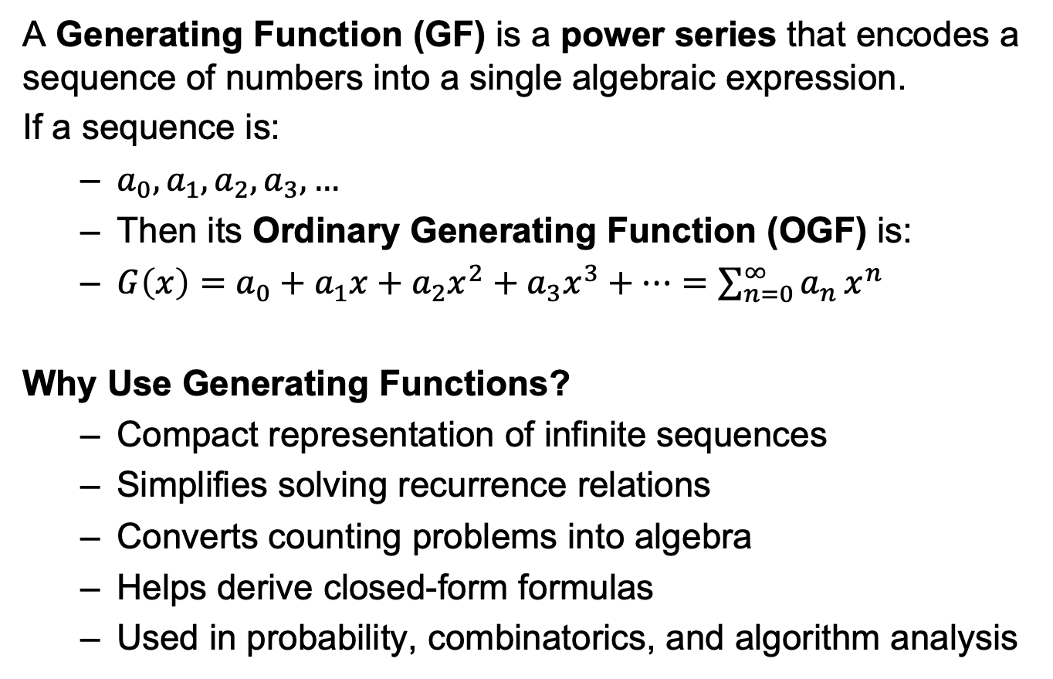
Generating Functions
A Generating Function (GF) is a power series that encodes a sequence of numbers into a single algebraic expression.
If a sequence is:
$a_{0},a_{1},a_{2},a_{3},…$
Then its Ordinary Generating Function (OGF) is:
$G\left(x\right)=a_{0}+a_{1}x+a_{2}x^{2}+a_{3}x^{3}+⋯=\sum_{n=0}^{∞}{a_{n}}x^{n}$
Why Use Generating Functions?
Compact representation of infinite sequences
Simplifies solving recurrence relations
Converts counting problems into algebra
Helps derive closed-form formulas
Used in probability, combinatorics, and algorithm analysis

Slide 35
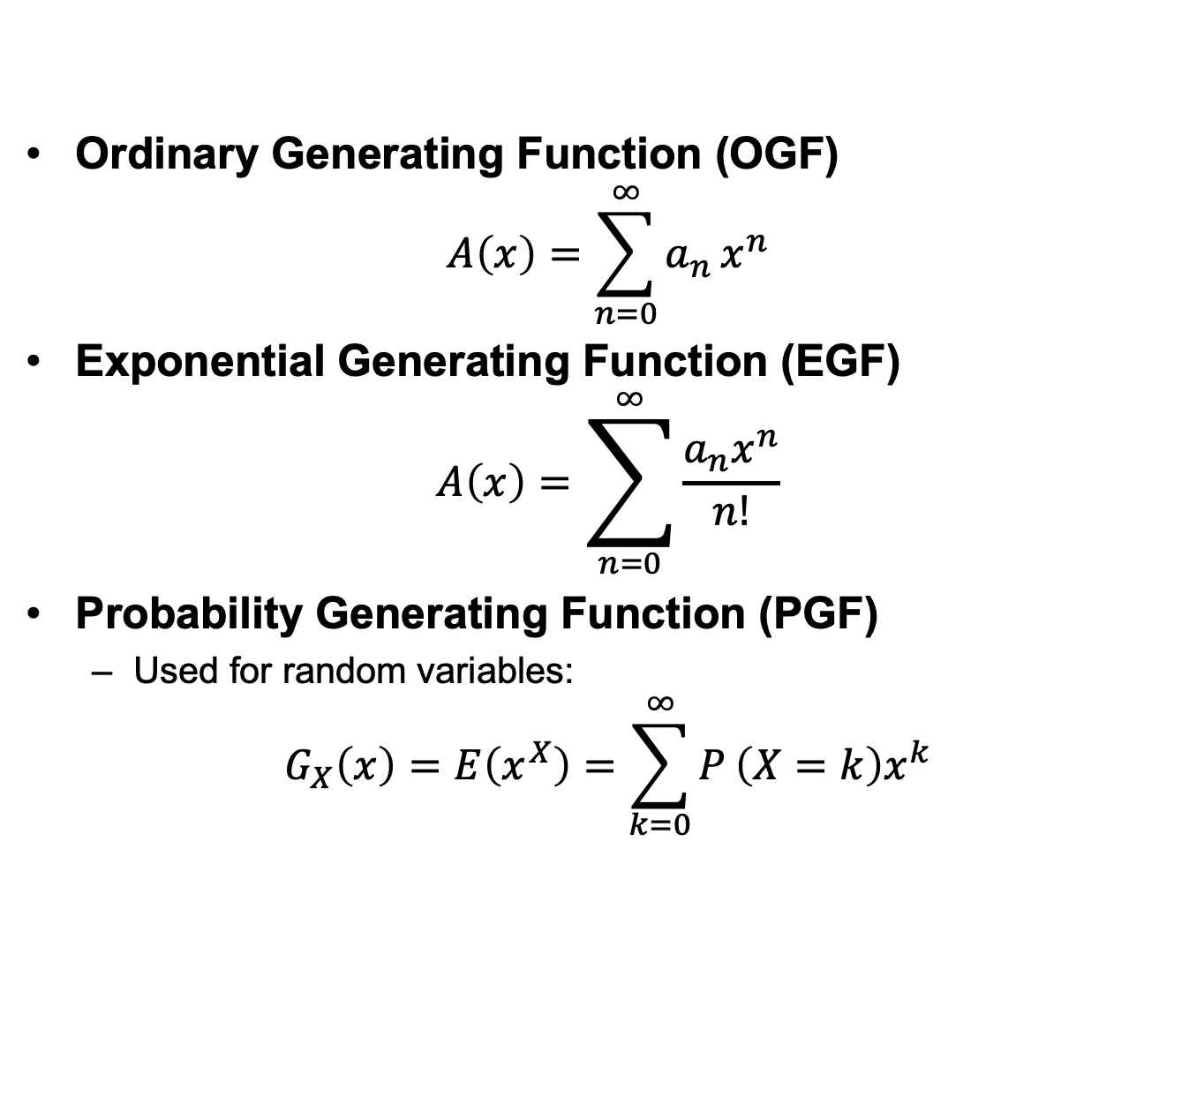
Types of Generating Functions
Ordinary Generating Function (OGF)
$$A\left(x\right)=\sum_{n=0}^{∞}{a_{n}}x^{n}$$
Exponential Generating Function (EGF)
$$A\left(x\right)=\sum_{n=0}^{∞}{\frac{a_{n}x^{n}}{n!}}$$
Probability Generating Function (PGF)
Used for random variables:
$$G_{X}\left(x\right)=E\left(x^{X}\right)=\sum_{k=0}^{∞}{P}\left(X=k\right)x^{k}$$

